Slide 1

Big Data Infrastructure
CS 489/698 Big Data Infrastructure (Winter 2016)
Week 11: Analyzing Graphs, Redux (1/2)
March 22, 2016
Jimmy Lin
David R. Cheriton School of Computer Science
University of Waterloo
These slides are available at http://lintool.github.io/bigdata-2016w/
This work is licensed under a Creative Commons Attribution-Noncommercial-Share Alike 3.0 United States See http://creativecommons.org/licenses/by-nc-sa/3.0/us/ for details

Slide 2
Structure of the Course
Analyzing Text
Analyzing Relational Data
Analyzing Graphs
Data Mining
“Core” framework features and algorithm design

Slide 3
Characteristics of Graph Algorithms
Parallel graph traversals
Local computations
Message passing along graph edges
Iterations

Slide 4
PageRank: Defined
Given page x with inlinks t₁…t_{n}, where
C(t) is the out-degree of t
α is probability of random jump
N is the total number of nodes in the graph
t₁
X
t₂
…
t_{n}

Slide 5
PageRank in MapReduce
n₁ [n₂, n₄]
n₂ [n₃, n₅]
n₃ [n₄]
n₄ [n₅]
n₅ [n₁, n₂, n₃]
Map
n₂
n₄
n₃
n₅
n₄
n₅
n₁
n₂
n₃
n₁
n₂
n₂
n₃
n₃
n₄
n₄
n₅
n₅
Reduce
n₁ [n₂, n₄]
n₂ [n₃, n₅]
n₃ [n₄]
n₄ [n₅]
n₅ [n₁, n₂, n₃]

Slide 6
MapReduce Sucks
Java verbosity
Hadoop task startup time
Stragglers
Needless graph shuffling
Checkpointing at each iteration

Slide 7
Characteristics of Graph Algorithms
Parallel graph traversals
Local computations
Message passing along graph edges
Iterations
Spark to the rescue?

Slide 8
Let’s Spark!
HDFS
map
reduce
HDFS
map
reduce
HDFS
map
reduce
HDFS
…
(omitting the second MapReduce job for simplicity; no handling of dangling links)

Slide 9
HDFS
map
reduce
map
reduce
map
reduce
…

Slide 10
HDFS
map
Adjacency Lists
PageRank Mass
reduce
map
Adjacency Lists
PageRank Mass
reduce
map
Adjacency Lists
PageRank Mass
reduce
…

Slide 11
HDFS
map
Adjacency Lists
PageRank Mass
join
map
Adjacency Lists
PageRank Mass
join
map
Adjacency Lists
PageRank Mass
join
…

Slide 12
HDFS
HDFS
Adjacency Lists
PageRank vector
join
flatMap
reduceByKey
PageRank vector
join
flatMap
reduceByKey
PageRank vector
join
…

Slide 13
HDFS
HDFS
Adjacency Lists
PageRank vector
Cache!
join
flatMap
reduceByKey
PageRank vector
join
flatMap
reduceByKey
PageRank vector
join
…

Slide 14
MapReduce vs. Spark
Source: http://ampcamp.berkeley.edu/wp-content/uploads/2012/06/matei-zaharia-part-2-amp-camp-2012-standalone-programs.pdf

Slide 15
MapReduce Sucks
Java verbosity
Hadoop task startup time
Stragglers
Needless graph shuffling
Checkpointing at each iteration
What have we fixed?

Slide 16
Characteristics of Graph Algorithms
Parallel graph traversals
Local computations
Message passing along graph edges
Iterations

Slide 17
Big Data Processing in a Nutshell
Lessons learned so far:
Partition
Replicate
Reduce cross-partition communication
What makes MapReduce/Spark fast?

Slide 18
Characteristics of Graph Algorithms
Parallel graph traversals
Local computations
Message passing along graph edges
Iterations
What’s the issue?
Obvious solution: keep “neighborhoods” together!

Slide 19
Simple Partitioning Techniques
Hash partitioning
Range partitioning on some underlying linearization
Web pages: lexicographic sort of domain-reversed URLs
Social networks: sort by demographic characteristics

Slide 20
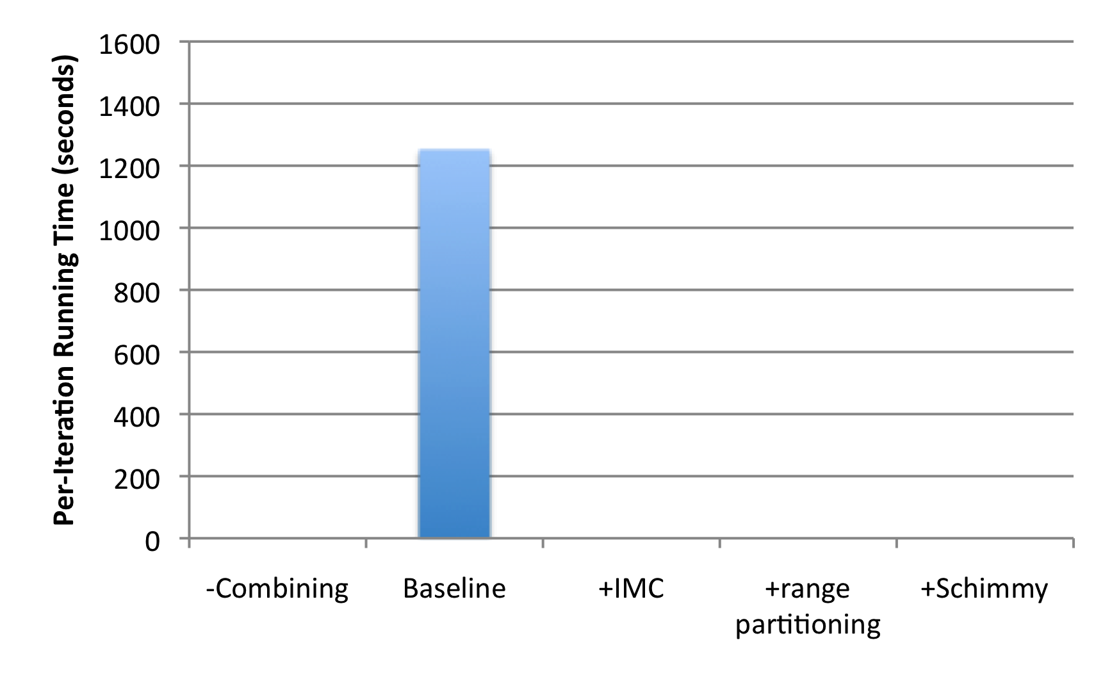
How much difference does it make?
“Best Practices”
PageRank over webgraph (40m vertices, 1.4b edges)
Lin and Schatz. (2010) Design Patterns for Efﬁcient Graph Algorithms in MapReduce.

Slide 21
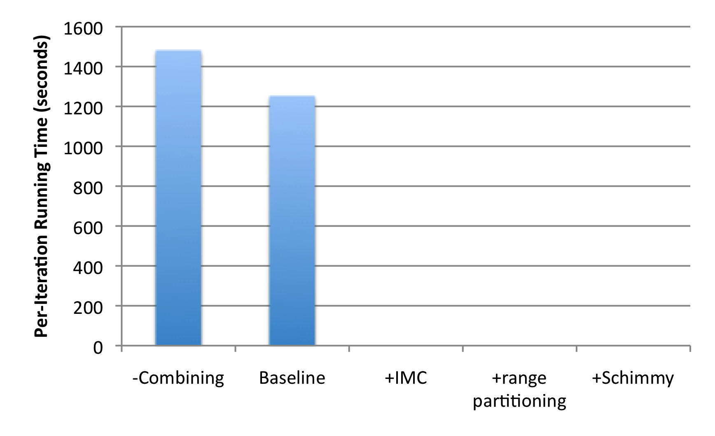
How much difference does it make?
+18%
1.4b
674m
PageRank over webgraph (40m vertices, 1.4b edges)
Lin and Schatz. (2010) Design Patterns for Efﬁcient Graph Algorithms in MapReduce.

Slide 22
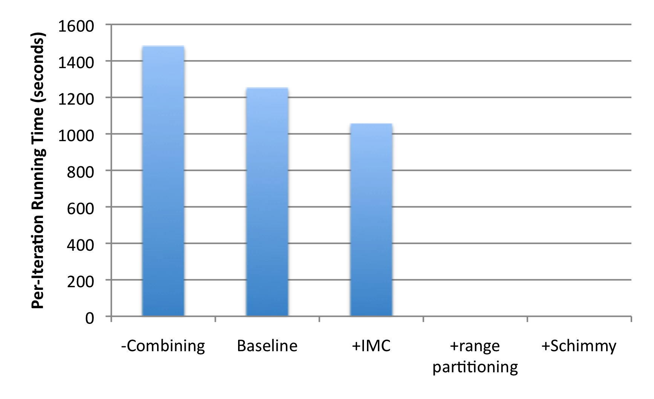
How much difference does it make?
+18%
1.4b
674m
-15%
PageRank over webgraph (40m vertices, 1.4b edges)
Lin and Schatz. (2010) Design Patterns for Efﬁcient Graph Algorithms in MapReduce.

Slide 23
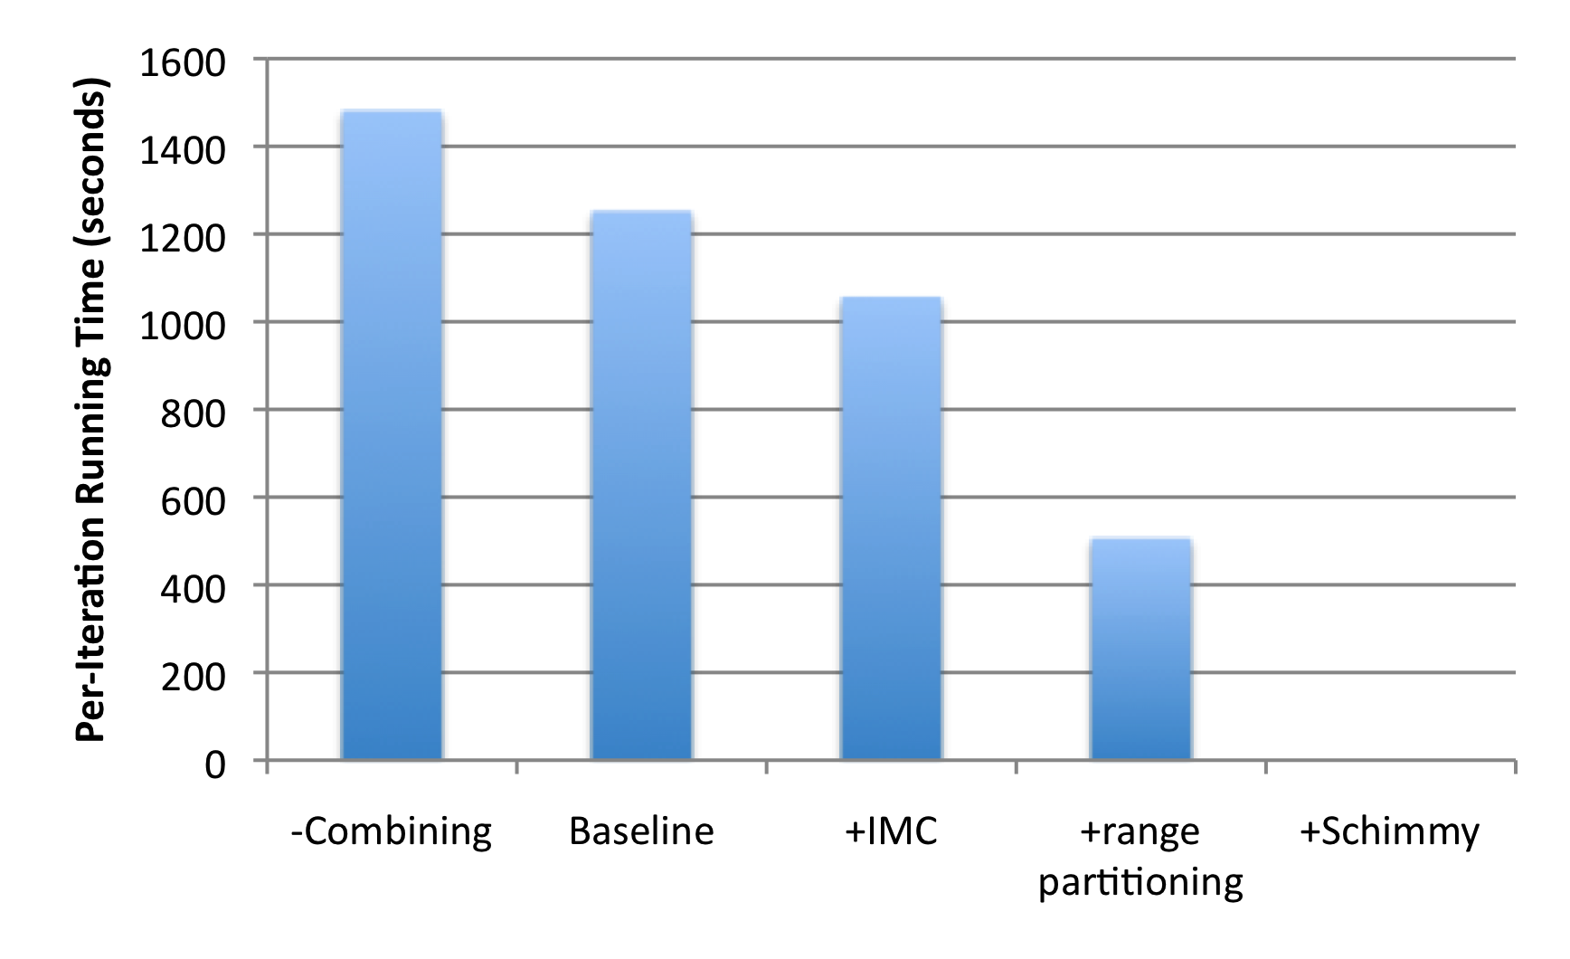
How much difference does it make?
+18%
1.4b
674m
-15%
-60%
86m
PageRank over webgraph (40m vertices, 1.4b edges)
Lin and Schatz. (2010) Design Patterns for Efﬁcient Graph Algorithms in MapReduce.

Slide 24
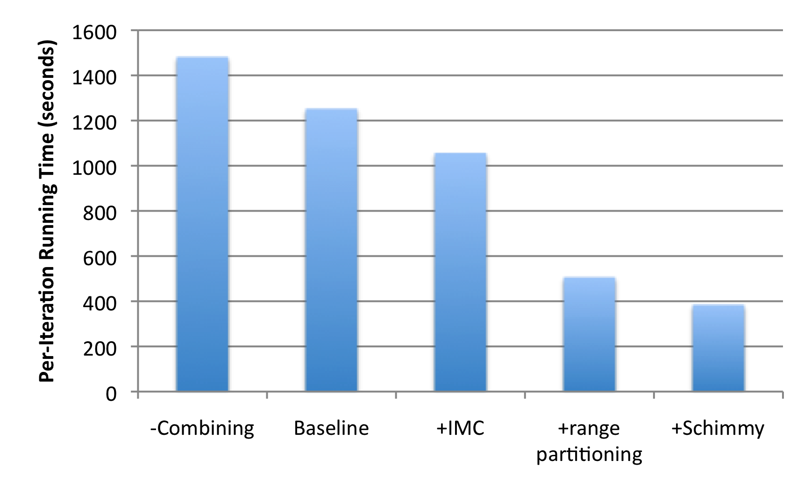
How much difference does it make?
+18%
1.4b
674m
-15%
-60%
86m
-69%
PageRank over webgraph (40m vertices, 1.4b edges)
Lin and Schatz. (2010) Design Patterns for Efﬁcient Graph Algorithms in MapReduce.

Slide 25
Country Structure in Facebook
Analysis of 721 million active users (May 2011)
54 countries w/ >1m active users, >50% penetration
Ugander et al. (2011) The Anatomy of the Facebook Social Graph.

Slide 26
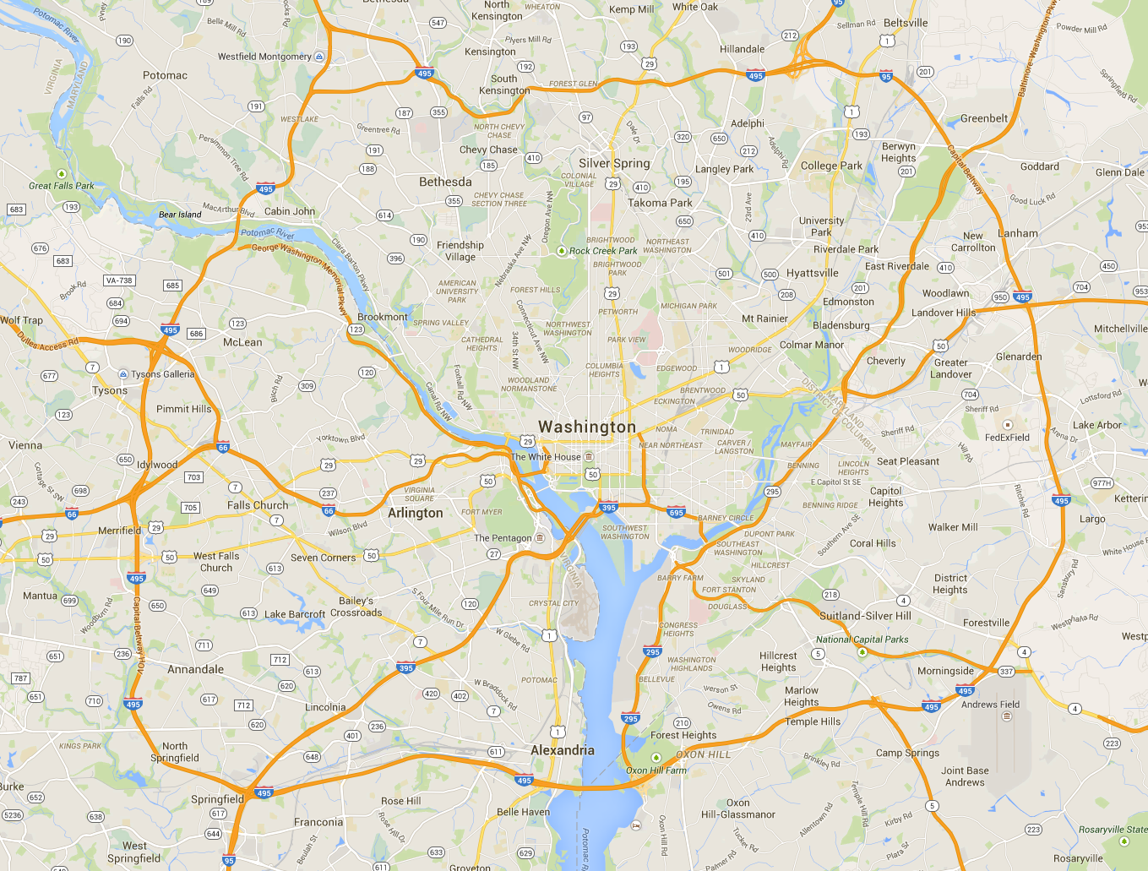
Aside: Partitioning Geo-data

Slide 27
Geo-data = regular graph

Slide 28
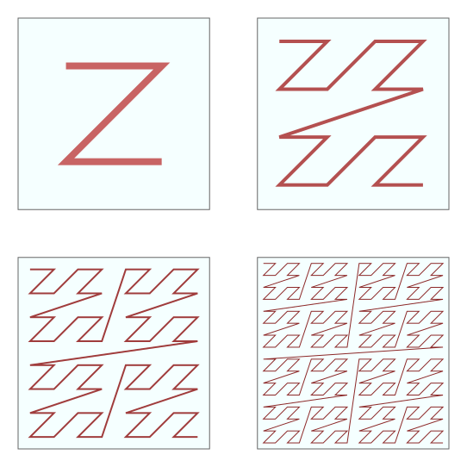
Space-filling curves: Z-Order Curves

Slide 29
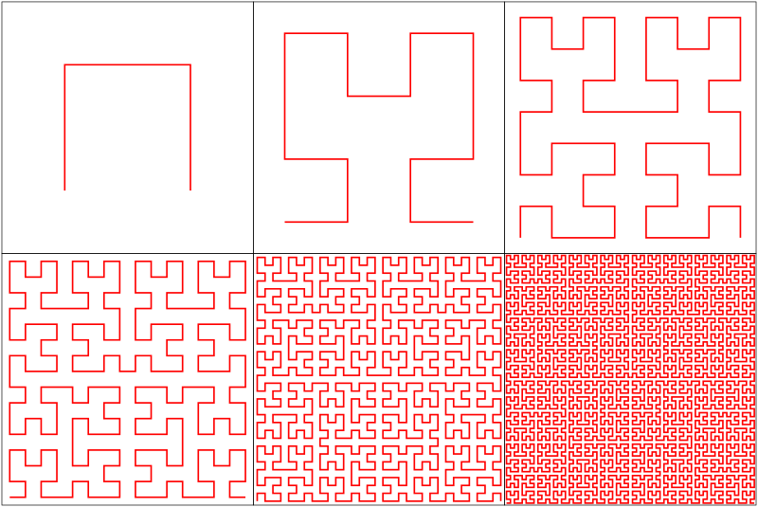
Space-filling curves: Hilbert Curves

Slide 30

Source: http://www.flickr.com/photos/fusedforces/4324320625/

Slide 31
General-Purpose Graph Partitioning
Karypis and Kumar. (1998) A Fast and High Quality Multilevel Scheme for Partitioning Irregular Graphs.

Slide 32
Graph Coarsening
Karypis and Kumar. (1998) A Fast and High Quality Multilevel Scheme for Partitioning Irregular Graphs.

Slide 33
Partition

Slide 34
Partition

Slide 35
Partition + Replicate
What’s the issue?
The fastest current graph algorithms combine smart partitioning with asynchronous iterations

Slide 36
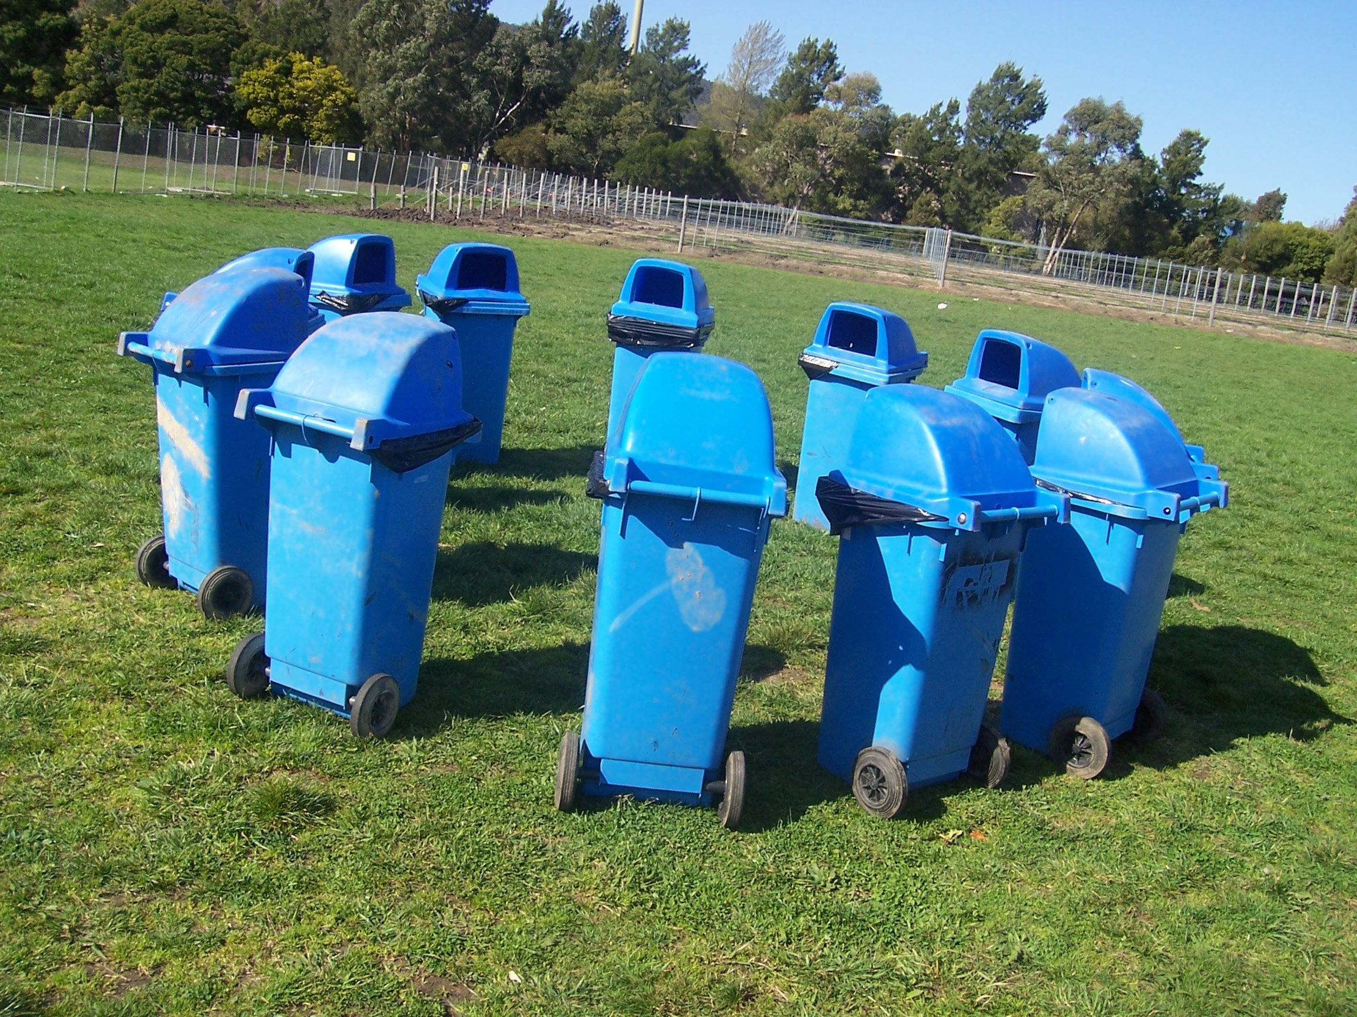
Graph Processing Frameworks
Source: Wikipedia (Waste container)

Slide 37
MapReduce PageRank
HDFS
map
map
Convergence?
reduce
HDFS
HDFS
What’s the issue?
Think like a vertex!

Slide 38
Pregel: Computational Model
Based on Bulk Synchronous Parallel (BSP)
Computational units encoded in a directed graph
Computation proceeds in a series of supersteps
Message passing architecture
Each vertex, at each superstep:
Receives messages directed at it from previous superstep
Executes a user-defined function (modifying state)
Emits messages to other vertices (for the next superstep)
Termination:
A vertex can choose to deactivate itself
Is “woken up” if new messages received
Computation halts when all vertices are inactive
Source: Malewicz et al. (2010) Pregel: A System for Large-Scale Graph Processing. SIGMOD.

Slide 39
Pregel
superstep t
superstep t+1
superstep t+2
Source: Malewicz et al. (2010) Pregel: A System for Large-Scale Graph Processing. SIGMOD.

Slide 40
Pregel: Implementation
Master-Slave architecture
Vertices are hash partitioned (by default) and assigned to workers
Everything happens in memory
Processing cycle:
Master tells all workers to advance a single superstep
Worker delivers messages from previous superstep, executing vertex computation
Messages sent asynchronously (in batches)
Worker notifies master of number of active vertices
Fault tolerance
Checkpointing
Heartbeat/revert
Source: Malewicz et al. (2010) Pregel: A System for Large-Scale Graph Processing. SIGMOD.

Slide 41
Pregel: PageRank
class PageRankVertex : public Vertex<double, void, double> {
public:
virtual void Compute(MessageIterator* msgs) {
if (superstep() >= 1) {
double sum = 0;
for (; !msgs->Done(); msgs->Next())
sum += msgs->Value();
*MutableValue() = 0.15 / NumVertices() + 0.85 * sum;
}
if (superstep() < 30) {
const int64 n = GetOutEdgeIterator().size();
SendMessageToAllNeighbors(GetValue() / n);
} else {
VoteToHalt();
}
}
};
Source: Malewicz et al. (2010) Pregel: A System for Large-Scale Graph Processing. SIGMOD.

Slide 42
Pregel: SSSP
class ShortestPathVertex : public Vertex<int, int, int> {
void Compute(MessageIterator* msgs) {
int mindist = IsSource(vertex_id()) ? 0 : INF;
for (; !msgs->Done(); msgs->Next())
mindist = min(mindist, msgs->Value());
if (mindist < GetValue()) {
*MutableValue() = mindist;
OutEdgeIterator iter = GetOutEdgeIterator();
for (; !iter.Done(); iter.Next())
SendMessageTo(iter.Target(),
mindist + iter.GetValue());
}
VoteToHalt();
}
};
Source: Malewicz et al. (2010) Pregel: A System for Large-Scale Graph Processing. SIGMOD.

Slide 43
Pregel: Combiners
class MinIntCombiner : public Combiner<int> {
virtual void Combine(MessageIterator* msgs) {
int mindist = INF;
for (; !msgs->Done(); msgs->Next())
mindist = min(mindist, msgs->Value());
Output("combined_source", mindist);
}
};
Source: Malewicz et al. (2010) Pregel: A System for Large-Scale Graph Processing. SIGMOD.

Slide 45
Giraph Architecture
Master – Application coordinator
Synchronizes supersteps
Assigns partitions to workers before superstep begins
Workers – Computation & messaging
Handle I/O – reading and writing the graph
Computation/messaging of assigned partitions
ZooKeeper
Maintains global application state
Giraph slides borrowed from Joffe (2013)

Slide 46
Giraph Dataflow
1
2
3
Loading the graph
Compute/Iterate
Storing the graph
Input format
In-memory graph
Output format
Split 0
Worker 0
Load / Send
Graph
Compute / Send
Messages
Part 0
Part 0
Worker 0
Worker 0
Split 1
Part 1
Part 0
Master
Split 2
Master
Part 1
Part 1
Split 3
Load / Send
Graph
Part 2
Compute / Send
Messages
Part 2
Worker 1
Part 3
Worker 1
Worker 1
Part 2
Split 4
Part 3
Part 3
Split
Send stats / iterate!

Slide 47
Giraph Lifecycle
Vertex Lifecycle
Vote to Halt
Active
Inactive
Input
Received Message
Compute Superstep
All Vertices Halted?
Yes
Output
No
Master halted?
Yes
No

Slide 48
Giraph Example

Slide 49
Execution Trace
Processor 1
5
5
5
5
Processor 2
1
1
5
5
5
2
2
2
5
5
Time

Slide 50
Graph Processing Frameworks
Source: Wikipedia (Waste container)

Slide 51
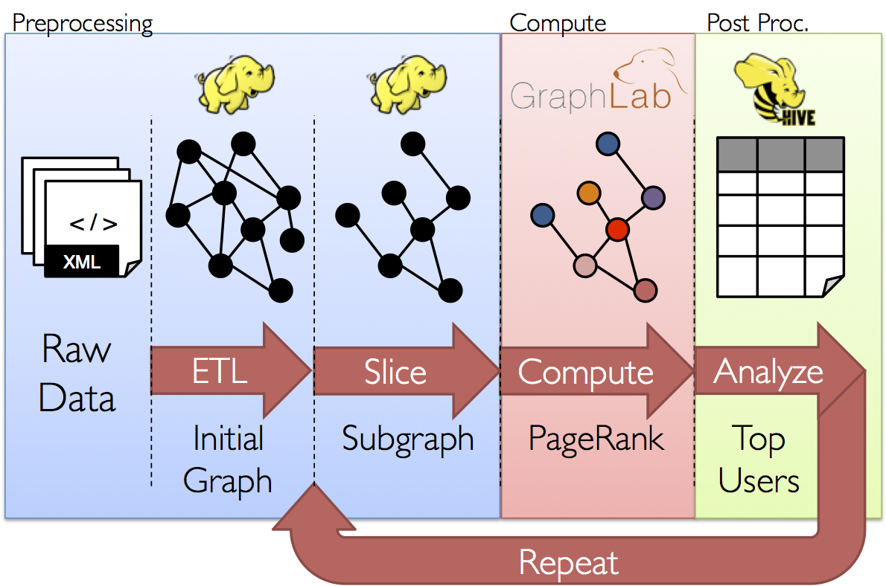
GraphX: Motivation

Slide 52
GraphX = Spark for Graphs
Integration of record-oriented and graph-oriented processing
Extends RDDs to Resilient Distributed Property Graphs
Property graphs:
Present different views of the graph (vertices, edges, triplets)
Support map-like operations
Support distributed Pregel-like aggregations

Slide 53
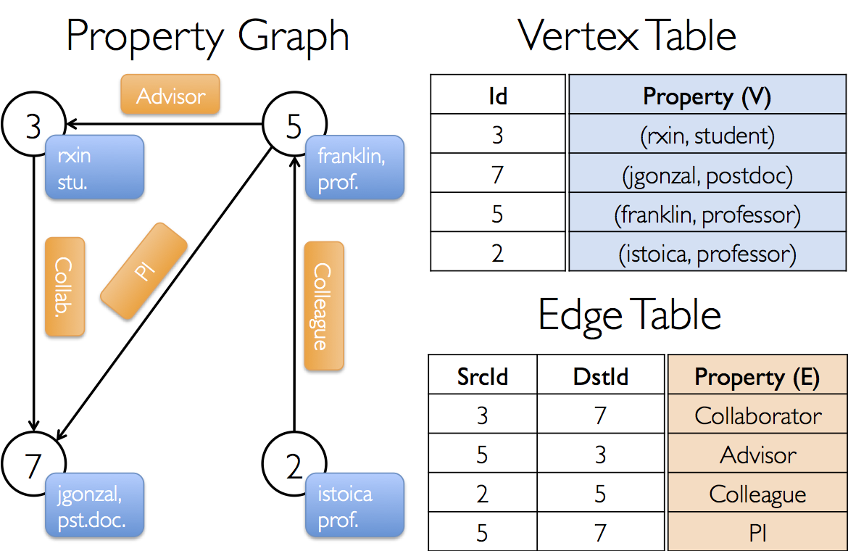
Property Graph: Example

Slide 54
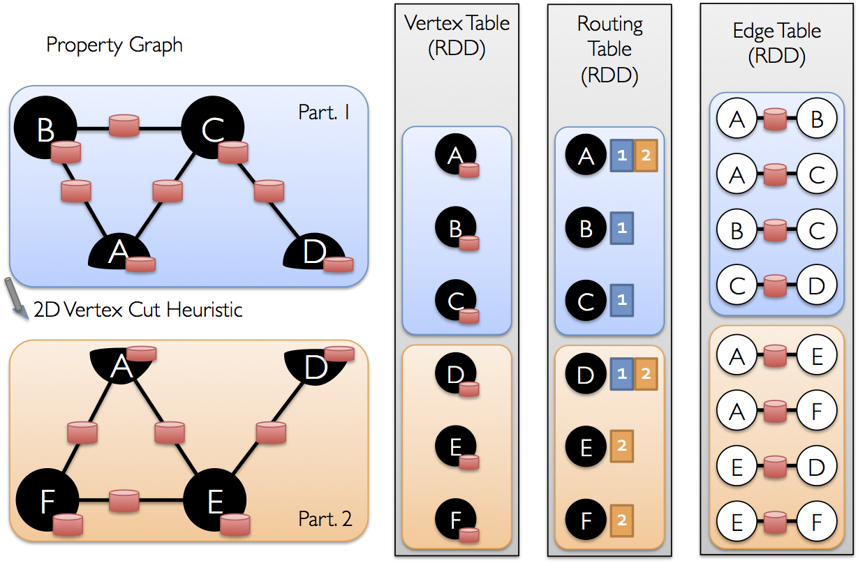
Underneath the Covers

Slide 55

Questions?
Source: Wikipedia (Japanese rock garden)

